Slide 1

Centers for Medicare & Medicaid Services
ML Implementation on Medicare Services
ADTA 5340 - Group 9
Saideep Taddi
Saisudha Gonthina

Slide 2

Topics to cover
Introduction to CMS
How ML and AI are being used in Medicare Services
Problem to Solve
Dataset
Dataset Explanation
Data Preparation
Exploratory Data Analysis
Algorithms
Algorithms Comparison
Predictions
How does this help the Medicare Services

Slide 3
Introduction to CMS
CMS specifies the Centers for Medicare and Medicaid services, and it provides the data that helps in better understanding of CMS programs.
The data includes information on the use, payment, and hospital charges for more than 3000 U.S hospitals that received IPPS payments.
This data is organized by the hospital and Medicare Severity Diagnosis Related Group (DRG). There are more than seven million discharges by using these DRGs.
Hospitals will charge for items and services provided to patients and the total payment amount includes the DRG amount, claim per diem amount, beneficiary primary payer claim payment amount, beneficiary Part A (Hospital Insurance) coinsurance amount, beneficiary deductible amount, beneficiary blood deductible amount and diagnosis related group outlier amount.

Slide 4
How ML and AI are being used in Medicare Services
Now a days, we see AI is used in medication sector, for scheduling prediction of mortality and remediation risk.
In pharma, drug makers use AI to process huge volumes of data and will make research and development more efficient.
AI helps on platforms for automotive appointment systems.
Other areas where ML is used are real-time health status monitoring, disease detection, health risk assessment, drug development, administration, and communication.

Slide 5
Problem to Solve
Which drug has been purchased more frequently?
How much people are spending on that drug on an average?

Slide 6
Dataset
Medicare Inpatient Hospitals - by Provider and Service ( Centers for Medicare & Medicaid: https://data.cms.gov/ )

Slide 7
Dataset Explanation
Term Name | Variable Name | Definition
Rendering Provider CCN | Rndrng_CCN | The CMS Certification Number (CCN) of the provider billing for outpatient hospital services.
Rendering Provider Name | Rndrng_Prvdr_Org_Name | The name of the provider.
Rendering Provider Street Address | Rndrng_Prvdr_St | The street address in which the provider is physically located.
Rendering Provider City | Rndrng_Prvdr_City | The city in which the provider is physically located.

Slide 8
Dataset Explanation
Term Name | Variable Name | Definition
Rendering Provider State Abbreviation | Rndrng_Prvdr_State_Abrvtn | The state abbreviation for the state in which the provider is physically located.
Rendering Provider State FIPS Code | Rndrng_Prvdr_State_FIPS | The state FIPS code for the state in which the provider is physically located.
Rendering Provider Zip Code | Rndrng_Prvdr_Zip5 | The zip code in which the provider is physically located.
Rendering Provider Rural-Urban Commuting Code | Rndrng_Prvdr_RUCA | The Rural-Urban Commuting Area (RUCA) code for the zip code in which the provider is physically located. RUCA codes classify zip codes as rural/urban areas based on measures of population density, level of urbanization, and daily commuting patterns. These codes are developed by United States Department of Agriculture, Economic Research Service.

Slide 9
Dataset Explanation
Term Name | Variable Name | Definition
Rendering Provider Rural-Urban Commuting Area Description | Rndrng_Prvdr_RUCA_Desc | The description of the RUCA code. RUCA codes classify zip codes as rural/urban areas based on measures of population density, level of urbanization, and daily commuting patterns. These codes are developed by United States Department of Agriculture, Economic Research Service.
Diagnosis Related Group (DRG) Definition | DRG_Cd | Classification system that groups similar clinical conditions (diagnoses) and the procedures furnished by the hospital during the stay.
Diagnosis Related Group (DRG) Description | DRG_Desc | Description of the classification system (DRG) that groups similar clinical conditions (diagnoses) and the procedures furnished by the hospital during the stay.
Total Discharges | Tot_Dschrgs | The number of discharges billed by all providers for inpatient hospital services.

Slide 10
Dataset Explanation
Term Name | Variable Name | Definition
Average Covered Charges | Avg_Submtd_Cvrd_Chrg | The average charge of all providers' services covered by Medicare for discharges in the DRG. These will vary from hospital to hospital because of differences in hospital charge structures.
Average Total Payments | Avg_Tot_Pymt_Amt | The average total payments to all providers for the DRG including the MS-DRG amount, teaching, disproportionate share, capital, and outlier payments for all cases. Also included in average total payments are co-payment and deductible amounts that the patient is responsible for and any additional payments by third parties for coordination of benefits.
Average Medicare Payments | Avg_Mdcr_Pymt_Amt | The average amount that Medicare pays to the provider for Medicare's share of the MS-DRG. Medicare payment amounts include the MS-DRG amount, teaching, disproportionate share, capital, and outlier payments for all cases. Medicare payments DO NOT include beneficiary co- payments and deductible amounts nor any additional payments from third parties for coordination of benefits.

Slide 11
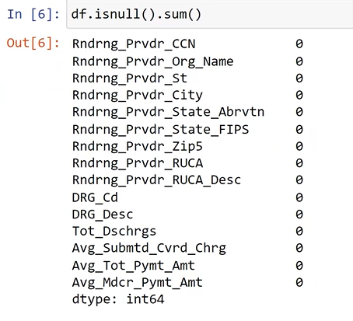
Data Preparation
Missing data and Outliers
From the code block, there are no null values in the dataset.
There are no missing values and outliers in the dataset.

Slide 12
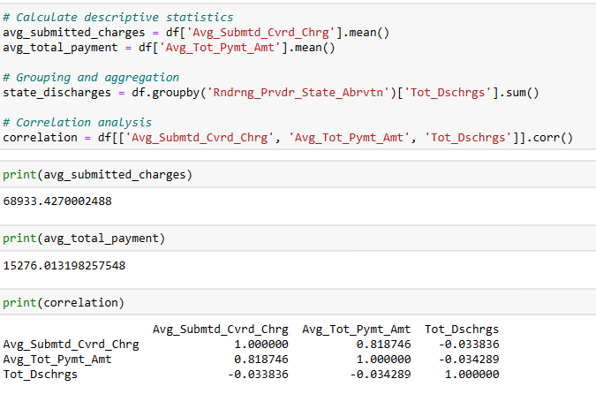
Data Preparation
Correlations

Slide 13
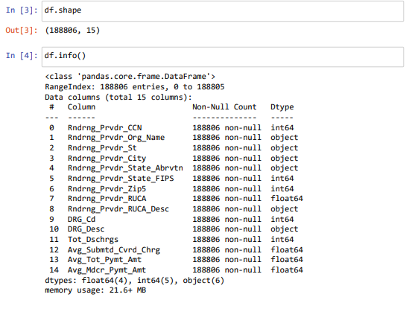
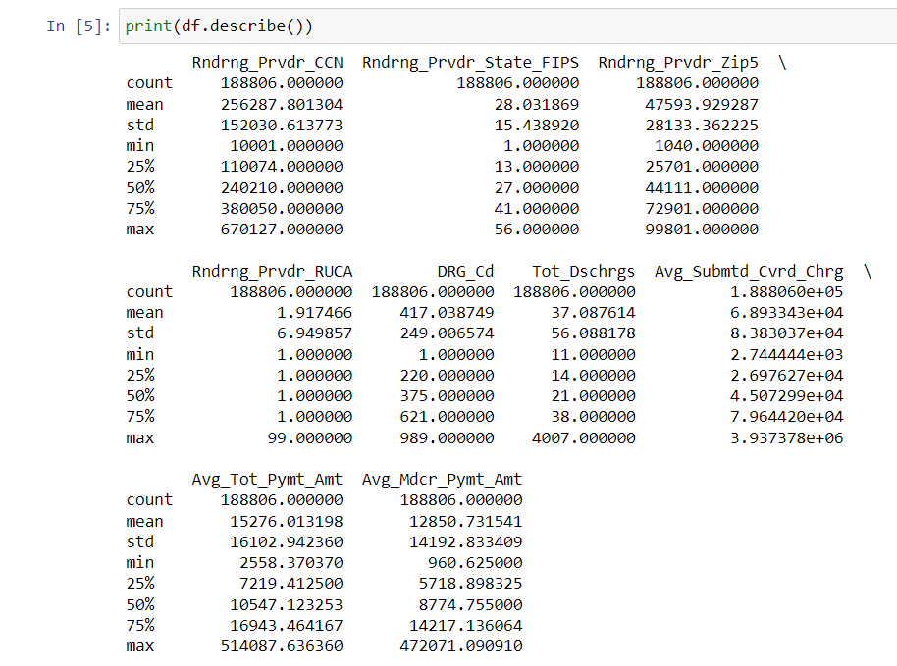
Exploratory Data Analysis
Summary Statistics

Slide 14
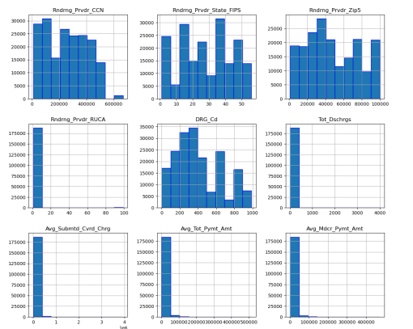
Histograms

Slide 15
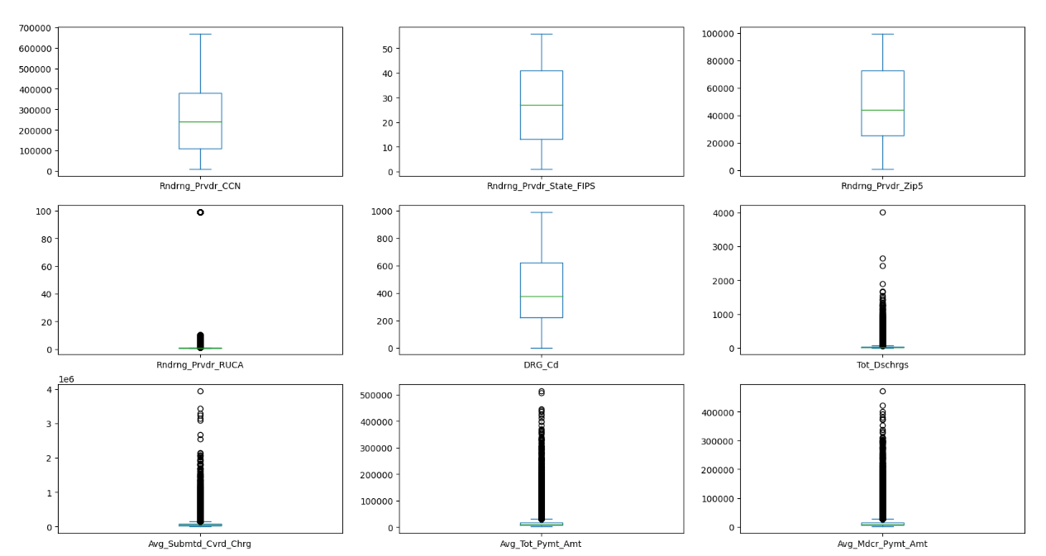
Box Plots

Slide 16
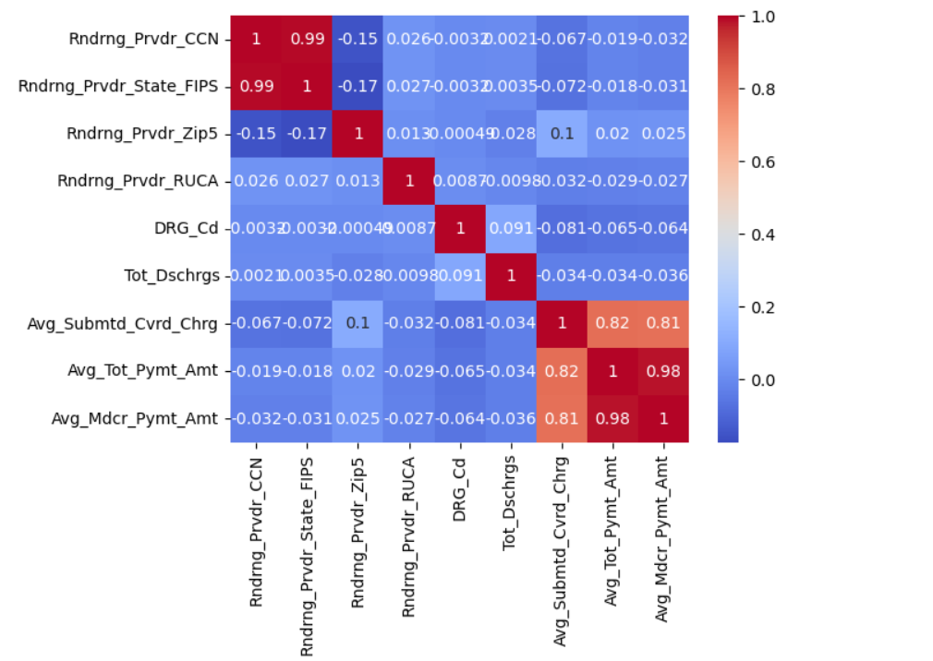
Heatmap
Here we performed an analysis we check the correlation in the heat map beside the last three variables
Avg_Submtd_Cvrd_Chrg
Avg_Tot_Pymt_Amt
Avg_Mdcr_Pymt_Amt
Are highly correlated when compared to any other variables in the data set

Slide 17
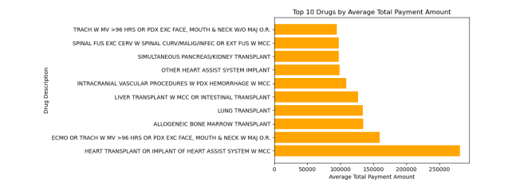
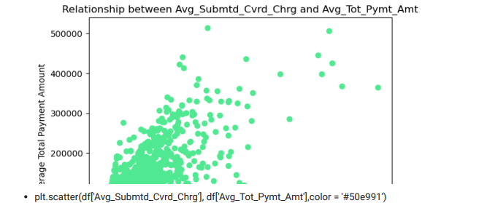
Average Total Payment Amount by Drug: We can calculate the average total payment amount (Avg_Tot_Pymt_Amt) for each drug (DRG_Desc) and display the results in a horizontal bar chart.
The resulting visualization is a horizontal bar chart that displays the top 10 drugs by average total payment amount.
The drug descriptions are shown on the y-axis, and the corresponding average payment amounts are represented by the length of the bars. The chart provides insights into the drugs with the highest average total payment amounts
Relationship between Average Submitted Covered Charges and Average Total Payment Amount: We can create a scatter plot to visualize the relationship between the average submitted covered charges (Avg_Submtd_Cvrd_Chrg) and the average total payment amount (Avg_Tot_Pymt_Amt) for the drugs.
The resulting visualization is a scatter plot that shows the relationship between the average submitted covered charges and the average total payment amount.
Each point in the plot represents a data point from the Data Frame df, where the x-coordinate represents the average submitted covered charges and the y-coordinate represents the average total payment amount.
The scatter plot allows you to visualize and understand the relationship or pattern, if any, between these two variables.

Slide 18
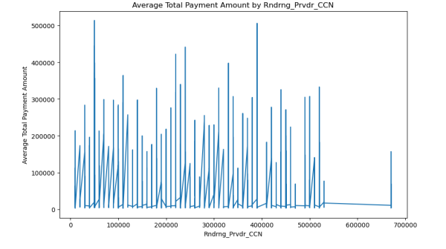
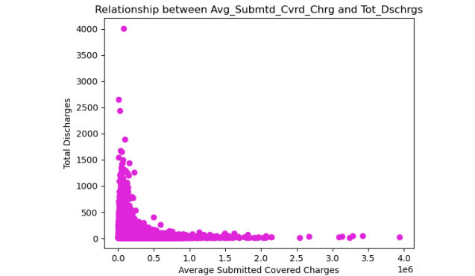
Line plot to show the average total payment amount (Avg_Tot_Pymt_Amt) over a range of values for the Rndrng_Prvdr_CCN column.
The resulting visualization is a line plot that shows the relationsh between the average total payment amount and the rendering provider' Certification Number.
Each point in the plot represents a data point the DataFrame df, where the x-coordinate represents the CMS Certific Number and the y-coordinate represents the average total payment amount The line plot allows you to visualize the trend or pattern, if any, data.
Relationship between Average Submitted Covered Charges and Total Discharges: We can visualize the relationship between the average submitted covered charges (Avg_Submtd_Cvrd_Chrg) and the total discharges (Tot_Dschrgs) using a scatter plot.
The resulting visualization is a scatter plot that shows the relationship between the average submitted covered charges and the total discharges.
Each point in the plot represents a data point from the DataFrame df, where the x-coordinate represents the average submitted covered charges and the y-coordinate represents the total discharges.
The scatter plot allows you to visualize and understand the relationship or pattern, if any, between these two variables.

Slide 19
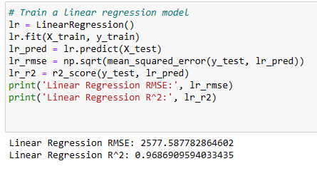
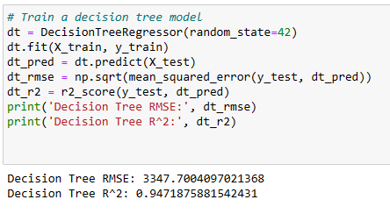
Algorithms
Linear Regression Model
Decision Tree Model

Slide 20
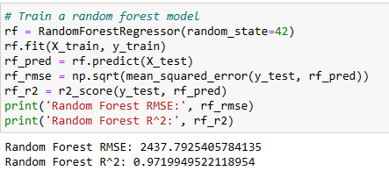
Algorithms
Random Forest Model

Slide 21
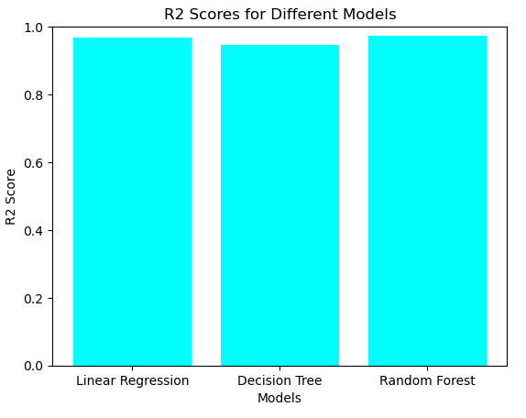
Algorithms Comparison
Decision tree model is less accurate when compared to the linear regression and random forest.
In between linear regression and random forest. Random forest had shown more accuracy.
From the Algorithms used, Random Forest Model is preferred over the other two because the R2 value of this model is more when compared to other two models used.

Slide 22
Predictions
From the analysis, it is observed that Higher Amount of Payment is done Heart Transplant or Implant of Heart Assist System W MCC.
This makes it clear that on an average, most of the people are facing problems related to heart and are spending higher amounts for getting treated.
This can be minimized by maintaining healthy diet, regular physical activities and not using tobacco products.
Checking and controlling risk factors for heart disease and stroke such as high blood pressure, high cholesterol and high blood sugar or diabetes is very important.

Slide 23
How does this help the Medicare Services
From the analysis we suggest the Medicare Services to maximize the production of the drugs, doctors and the machinery that is related to heart or heart diseases.
On further analysis, We can predict the future concerns that are related to the medical issues making the drugs more accessible to more population.

Slide 24

Thank You!
Any Questions?

